Slide 1


UI/UX Analysis of Popular Apps
YouTube, Facebook, InShot, Lark Player & SnapTube — Identifying UI elements & UX patterns

Slide 2




YouTube UI/UX Elements
Shorts feed integration for vertical scrolling
Bottom navigation bar for easy access
Minimized video player with gesture controls

Slide 3


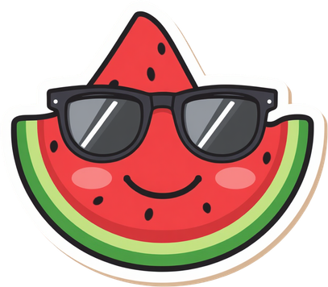

Facebook UI/UX Elements
News Feed infinite scroll with auto-refresh
Tab bar navigation for quick access
Stories carousel with reaction animations

Slide 4




InShot UI/UX Elements
Floating action buttons for quick tools
Timeline-based video editor
Preview-centric workspace with drag handles

Slide 5



Lark Player - UI/UX Elements
Floating video window pip mode
Gesture-based controls
Auto-folder organization with swipe navigation

Slide 6


Bottom navigation & gesture-based swiping are universal across all 5 apps.
Content-first design: media fills the screen, controls fade or hide.
Common UX Patterns
YouTube, Facebook, InShot, Lark Player & Snaptube share key interaction patterns.

Slide 7

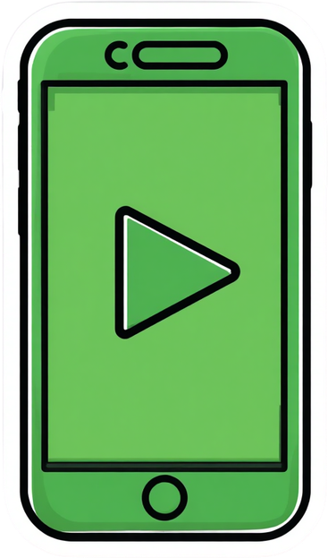

Thumb-first. Always.
Great mobile UX puts controls within thumb reach and keeps content flowing seamlessly.

